Slide 1
Who Gets Hired?
Tips for Success in Your
Internship/Job Search

Slide 2
Creating a Job Search Plan
Start with a Career Goal or Area of Interest
Identify your Strengths, Interests, and Types of Jobs
that Match
Learn about Employers you want to work for
Have job application materials ready (e.g. resume, cover letter)
Notes:
Think about short term and long term goals
Discuss The benefits of creating a job search plan

Slide 3
Know Your Available Resources
Advisement: Drop-in Hours & Appointments
Open Forums & Labs & Resource Workshops
Company Info Sessions
Events
Online Resources
Notes:
M-Th, 2-4 pm
When discussing events address question, Seventy percent (70%) of recruitment by companies is conducted during the fall season.
Career Fair, Get Hired, Networking mixers (VINE), Student Org Events, competitions & contests, Alumni panels
Open VCC website, Gateway, Vmock, Additional online resources in Gateway: Going Global, Inet,

Slide 4
Prepare
Customize a resume and cover letter for each application
Notes:
Address the question, The job search is a numbers game. The approach of casting a wide net and submitting as many job applications as possible is effective in securing you a position.
Touch on using Vmock, Resume Labs, and drop-in advisement

Slide 5
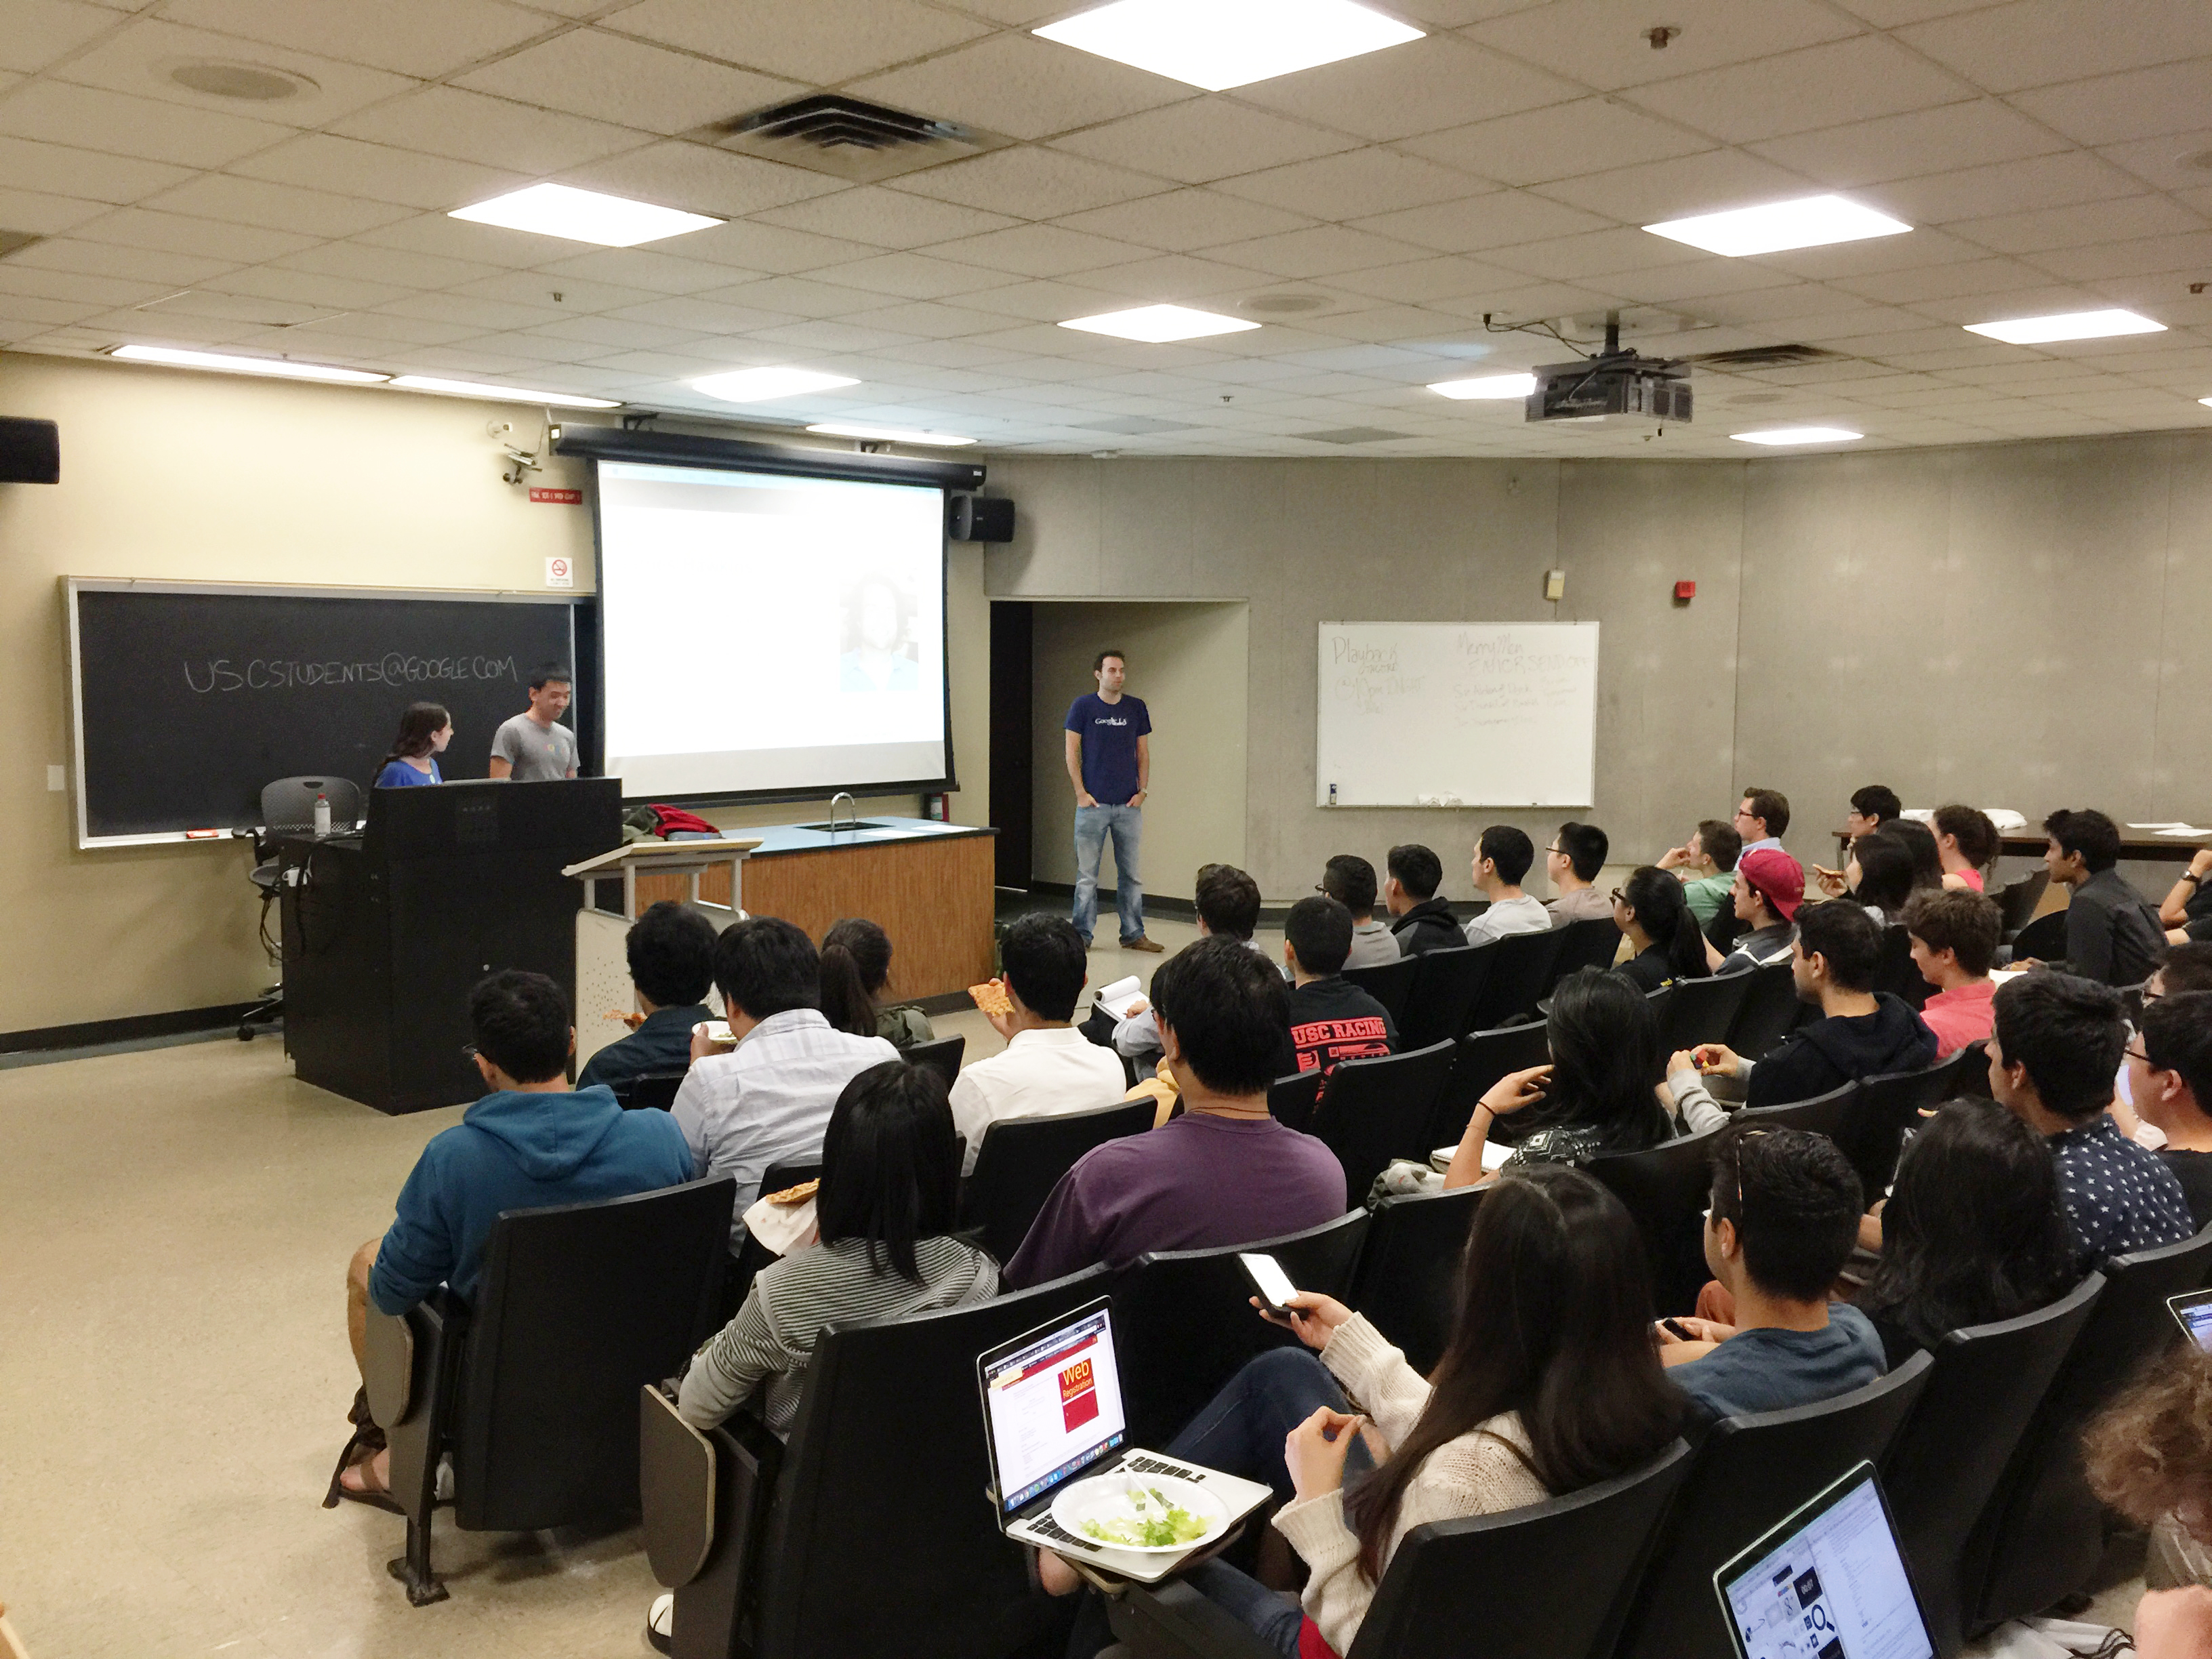
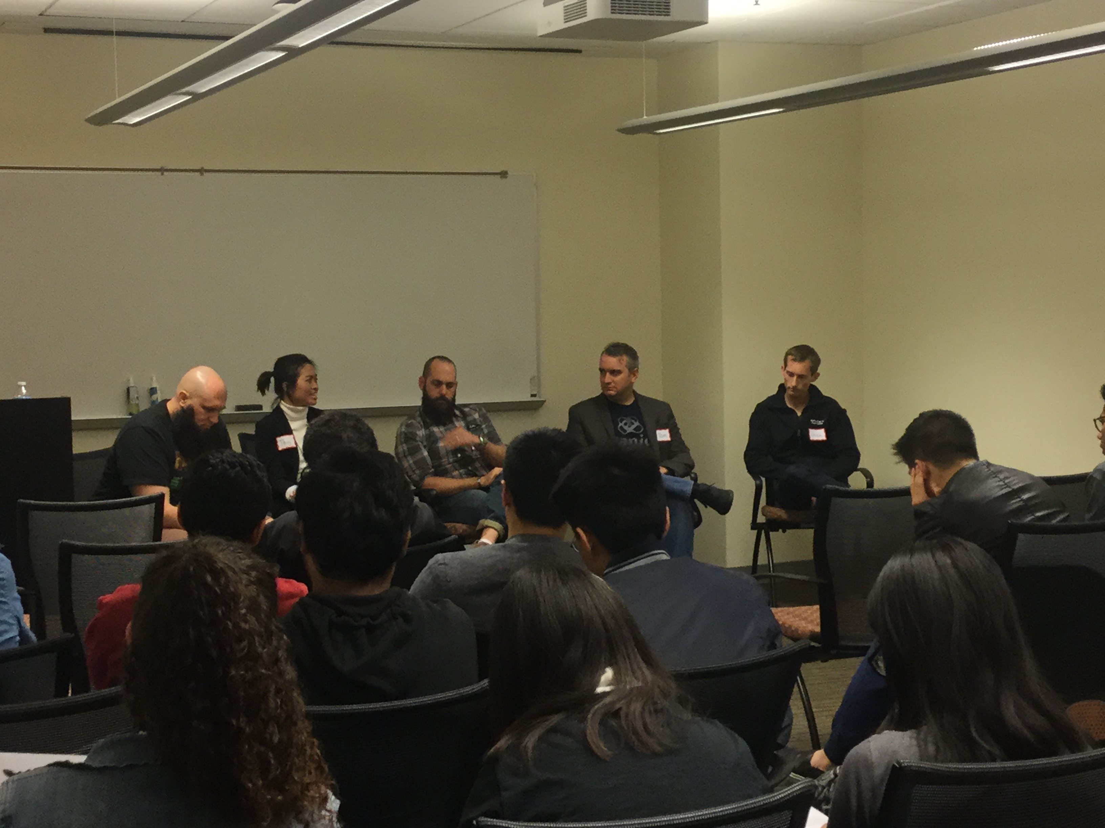
Connect
Student Organization Involvement
Information Sessions
Career Fairs
Networking Mixers
Alumni Panels
Competitions/Contests
LinkedIn
Viterbi Link
Meet with Faculty
Notes:
Discuss what networking is:
CONNECTING…with people who can answer questions about your field of interest.
CONVERSING…with individuals who can provide useful information about the job search process.
CAREER EXPLORATION…Increase awareness of career options.
PROFESSIONAL DEVELOPMENT…Understand the issues facing others in your field.
JOB SEARCH…Connections can provide access to the “hidden job market.”

Slide 6
Are you Career Ready?
Employers want to hire graduates who can articulate their skills, talents, interests and strengths
Notes:
Have students fill out a Career Readiness self-assessment tool
Discuss importance of these skills in the hiring process

